Slide 1
The Importance of Knowing What We Don't Know: Intellectual Humility and Anti-Racist Pedagogy
Michael Burns (Biology)
Susan Haarman (Center for Experiential Learning)
Joe Vukov (Philosophy)

Slide 2
Discussion
What are three areas in your discipline in which you don’t have expertise?
In your best moments, how do you interact with scholarship in these areas (at conferences, in your research, in conversation, etc.)?
How do you react when you get a question about one of these lesser known area, especially if it’s in a public arena (i.e. class, as a questions to a paper you’re presenting)?

Slide 3
Intellectual Humility
In our better moments, we often exhibit the virtue of intellectual humility while interacting with areas in our field in which we don’t have expertise.
Intellectual Humility includes:
Accurate Self-Assessment: knowing what we know and what we don’t know
Anti-Egotism: not caught up in our own desire to be right
Truth-Directed: a desire to understand ourselves and the world around us
Note: the truth directed aspect of IH is crucial. It gives IH a purpose and value. Moreover, a lack of IH is problematic not only on a personal level...it can also undermine our ability to understand ourselves and the world.

Slide 4
Do you encourage intellectual humility in your students?
If so, what’s one way you do so?

Slide 5
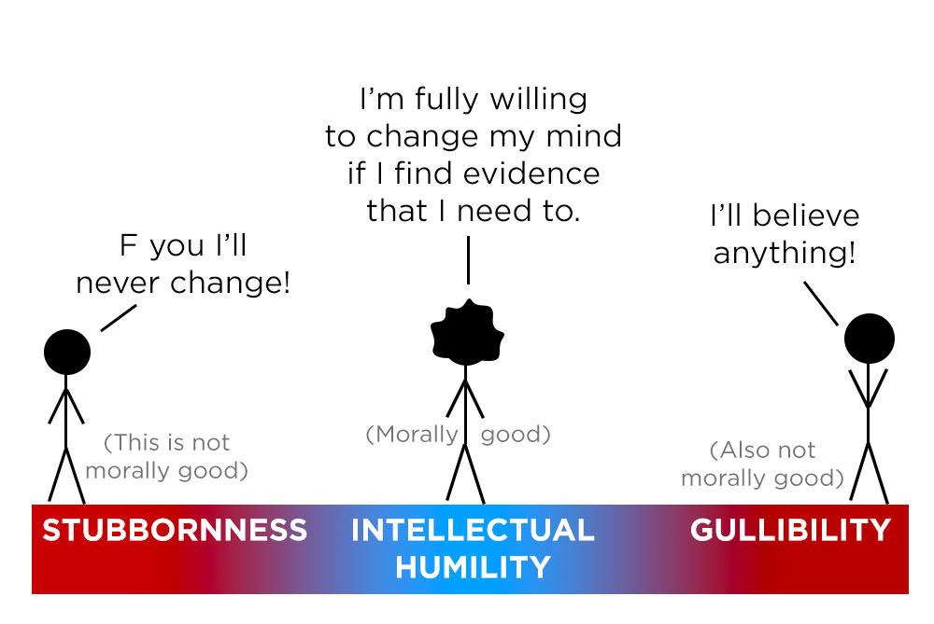
Intellectual Humility and Anti-Racist Pedagogy
Intellectual Humility is a cornerstone of anti-racist practice
Acknowledges that we all have epistemic blindspots, especially because of lived experiences
Anti-Racist Pedagogy and Intellectual Humility both prioritize the truth and are not culturally relative
Focus on acknowledgement of structural realities of racism
Examination of economic and social structures and historical roots of inequality.
Analyze unequal social and power relations.

Slide 6
Intellectual Humility, Anti-Racist Pedagogy & Ignatian Pedagogy
What is the place of lived experience in the classroom?
Anti-Racist pedagogy and Ignatian Pedagogy both highlight it as an epistemic force and essential context to learning
Inclusion of these experiences is a major issue of epistemic justice
Magnanimity cannot be present without humility in the Jesuit Tradition

Slide 7
Intellectual Humility and Anti-Racist Pedagogy
How do we engage with students who may call our approaches/verbage/terms into question, especially if we believe the content to be anti-racist?

Slide 8
Intellectual Humility and Anti-Racist Pedagogy
Are there areas in your field of study / practices in which you find it harder to practice intellectual humility around? Why or why not?
What are the major barriers to intellectual humility & anti-racist pedagogy you have experienced in the classroom? Focus on yourself before moving to students or structural components.

Slide 9
Is my teaching racist?
A question we need to ask ourselves:

Slide 10
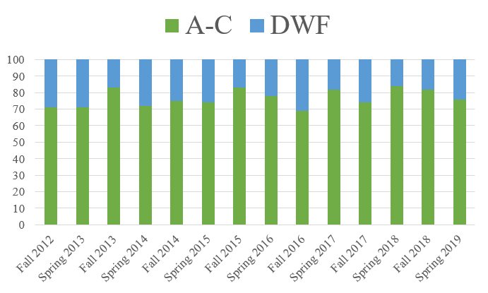
Is my teaching racist?
Compile your own grading data
Did any student groups disproportionately get Ds, Fs, or withdraw?

Slide 11
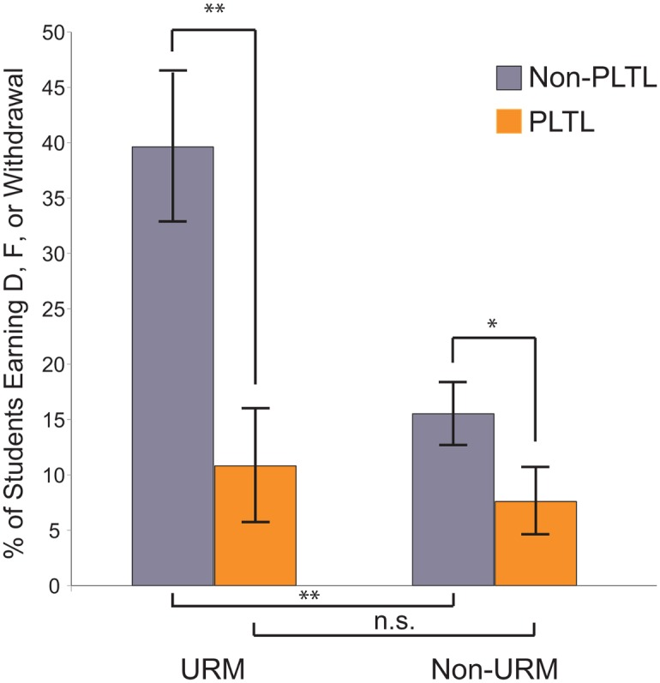
n = 479, Introductory Biology, Syracuse University
No intervention
Intervention
What trends do you see here?
Underrepresented Minority (URM) Students
Fig. 2, Snyder, et al. PLoS Biol. 2016 Mar; 14(3): e1002398.

Slide 12
n = 479, Introductory Biology, Syracuse University
No intervention
Intervention
Was the intervention successful?
Underrepresented Minority (URM) Students
Fig. 2, Snyder, et al. PLoS Biol. 2016 Mar; 14(3): e1002398. – Peer-led Team Learning (PLTL) Helps Minority Students Succeed

Slide 13
Classroom A
Classroom B
Sociology Course
Social Justice, Bias, Stereotype threat are all covered as main themes in the course
The class format is a traditional didactic lecture with little-to-no student interaction or feedback
Chemistry Course
Social Justice, Bias, Stereotype threat are never mentioned.
The course format is designed using evidence based practices that eliminate the achievement gap between URM and non-URM learners
What are the anti-racist elements present in each of these classrooms?
Which of these classes is most likely to help URM students succeed?

